Slide 1

Automation Of Pathology

Slide 2
Team Members
Prashant Gupta
2100290140104
Vinay Gupta
2100290140148
Shubham Dubey
2100290140132
Supervisor : Praveen Kumar Gupta
Assistant Professor
KIET Group Of Institutions

Slide 3
Project Overview
This project aims to develop a comprehensive and integrated software solution specifically designed for pathology laboratories. This software will streamline and automate various aspects of laboratory operations, including sample tracking, test ordering, result reporting, quality control, and inventory management.

Slide 4
Objective
The objective of the Automation of Pathology Project encompasses the development, implementation, and integration of a comprehensive software solution specifically designed for pathology laboratories. The software will cover various aspects of laboratory operations, including sample tracking, test ordering, result reporting, quality control, inventory management, and communication.
Notes:
Summarize your research in three to five points.

Slide 5
Admin Procedure
Step 1
Admin will Login
Step 2
Manage Lab Appointment
Step 3
Upload Sample result in report
Step 4
Generate bill & Report
Notes:
List all of the steps used in completing your experiment.
Remember to number your steps.

Slide 6
User Procedure
Step 1
Login / Register
Step 2
Book Appointment
Step 3
Date for Sample Collection
Step 4
View Report
Notes:
List all of the steps used in completing your experiment.
Remember to number your steps.

Slide 7
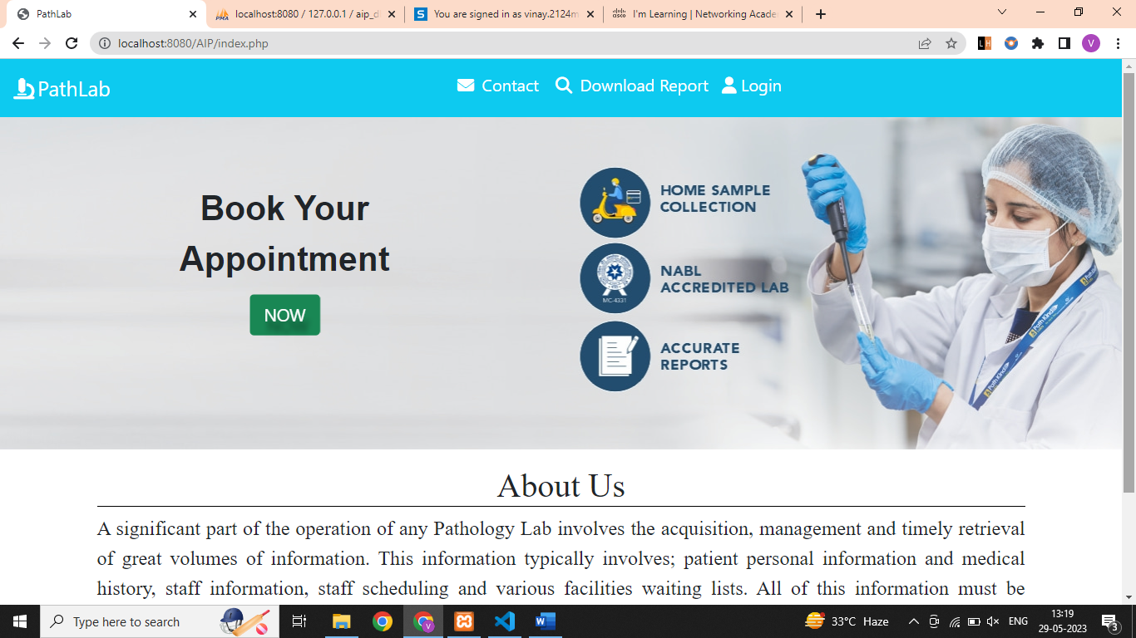
Overview of Project

Slide 8
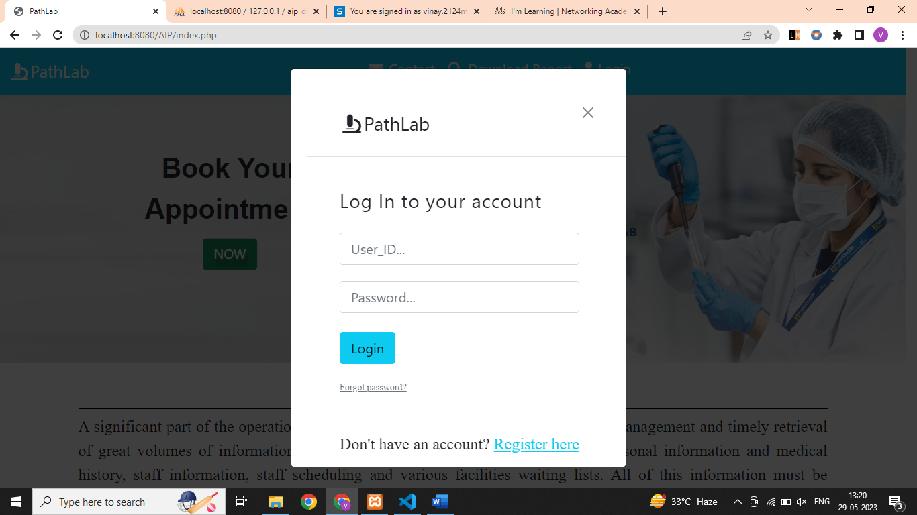
Overview of Login Form

Slide 9
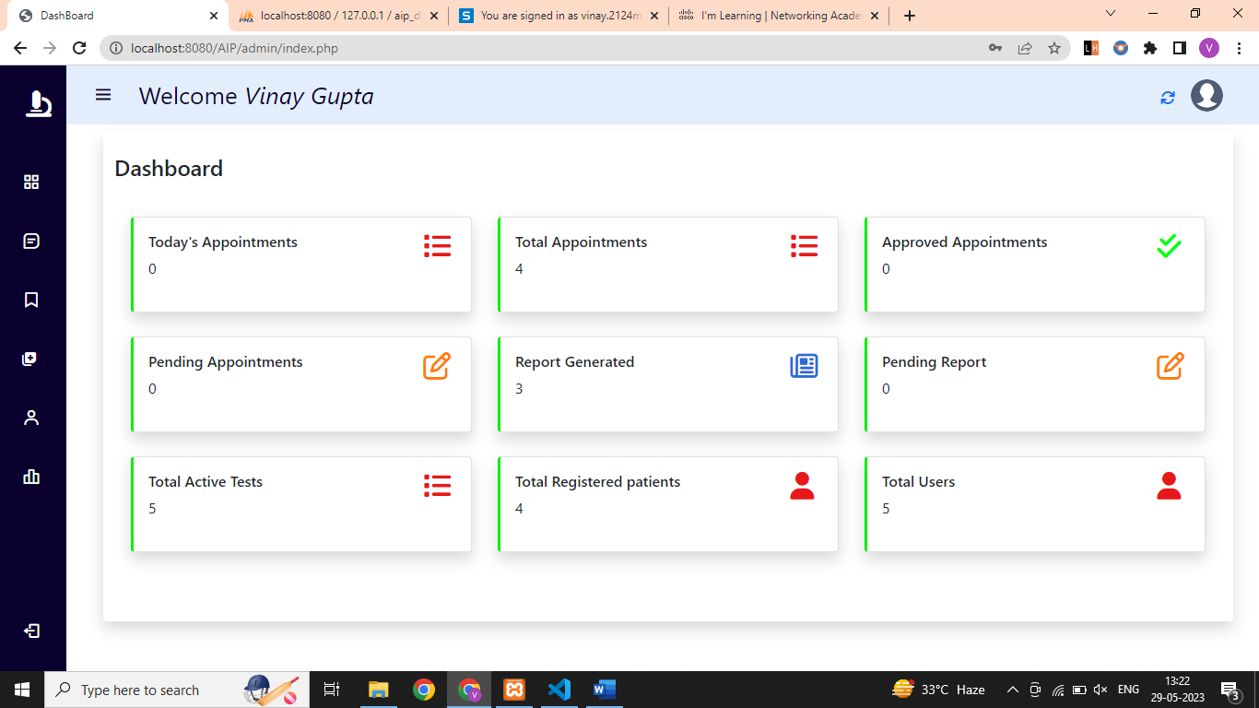
Dashboard view

Slide 10
Conclusion
The project has provided a user-friendly web interface for doctors, laboratory technicians, and patients, enabling them to interact seamlessly with the software system. Through automation, the project has significantly improved the efficiency and accuracy of critical processes such as patient registration, test ordering, sample collection, test result entry, and report generation

Slide 11
Thank You

